Slide 1
IE 511 – DOE Final Project Analysis of effects of changes in a poster layout on the reading time of graduate students
Team members: Ana Camargo Fahim Ahamed Tasnia Biswas

Slide 2
Introduction
Posters should be made in such a way that attracts people to read it and the layout should be such that people can read it fast, so they get they do not spend too much time to read the message included.
One of the goals of the experiment is to analyze the effects of changes in a poster layout on the average reading time of the chosen test subjects, so they can read the posters faster.
Another goal of this project is to find the treatment combination which would minimize the standard deviation of the reading times of the posters.
The experimental units of the project are the posters that will be prepared by the experimenters in a MS Word document and then printed on a letter sized page and the above-mentioned responses will be measured, keeping constant some other factors which will not be analyzed as part of the DOE.

Slide 3
Experimental units and Response variables
Experimental Unit: Posters prepared in a MS word document (with all different treatment combinations) and then printed on a letter sized paper (8.5"x11").
First Response Variable: mean of the reading time (repeated measurements, average of the time of 4 different grad students).
Second Response Variable: standard deviation of the time taken to 4 different grad students.
Response Variable | Measuring Device | Measurement Unit
1. Average time | Mobile Stopwatch | Seconds
2. Standard deviation | MS Excel calculation | Seconds

Slide 4
Main Factors and other variables
Control Variables and how will be controlled:
Factors | Control Scheme
Distance from poster to reader | Kept constant to 5 ft
Environmental lighting | Conducting the experiment indoors in the same room (private meeting room)
Words in each poster | Same English words in different order for each treatment
Education level of readers | Graduate Level
Height of the poster from the floor | Kept at readers’ eyes level
Physical dimension of posters | Letter size (8.5"x11") posters in a landscape orientation
Indications and timing | Done by the same person
Readers’ vision | Only readers who wears glasses and have the appropriate vision prescription
Main Variables: the factors below are considered to have influence on the response variables, varied at two levels.
Initially it was suspected that Factors A, E, G will have a significant effect on the response variables.
Factors | Level 1 (-1) | Level 2 (+1)
A: Font size | 16 | 18
B: Font color | Black | White
C: Letter case | Uppercase letters | Lowercase letters
D: Font style | Normal | Italic
E: Spacing | Single | Double
F: Background | Green (color model: RGB; Green 208) | Red (color model: RGB; Red 255)
G: Orientation (Text Direction) | Horizontal | Vertical (270°)
H: Font type | Arial | Courier New
Nuisance Variable:
Factors | Control Scheme
Word complexity | 2 complexities of words taken, based on CEFR levels: A2 and C1*.
*Source: https://www.cambridgeenglish.org

Slide 5
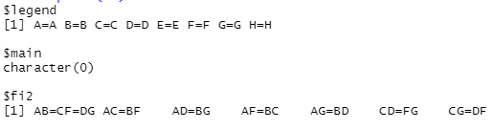
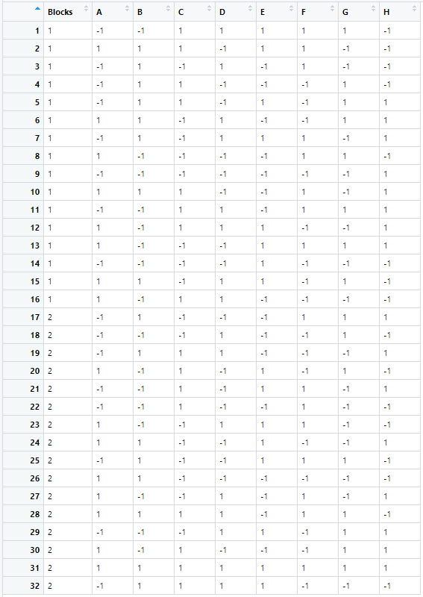

Design and Experimental Procedure
A 2_{IV}⁸⁻³ design with two blocks is selected to run this experiment. The design, alias structure and randomization was generated in R.
The design generators are F = ABC, G = ABD and H = BCDE (complete defining relation I = ABCF = ABDG = CDFG = BCDEH = ADEFH = ACEGH = BEFGH).
This design was chosen so we avoid main effects confounded with 2-factor interactions (see alias structure on Fig.1)
The block generator is [ABE] → ABE = CEF = DEG
Based on Boses’s theorem we decided only one block generator, because it was possible to find an arrangement s.t. no interaction confounded involving 2 or less factors ($2^{(8−3)−1}>8)$. Having 2 blocks generators (4 blocks) would have confound 2-factor interactions.
Total number of runs = 32 (16 for each block)
Each experimental unit was assigned randomly to a treatment combination (the randomized run order can be seen on Fig. 2)
Each treatment had repeated measurements, meaning that the posters were read by 4 different graduate students.
After the experiment was run, the mean and standard deviation of the times taken at each treatment combination were computed in a MS Excel file to tabulate into columns as the response's variables.
Fig 1: Alias structure
Fig 2: Randomized Design model (run order)

Slide 6
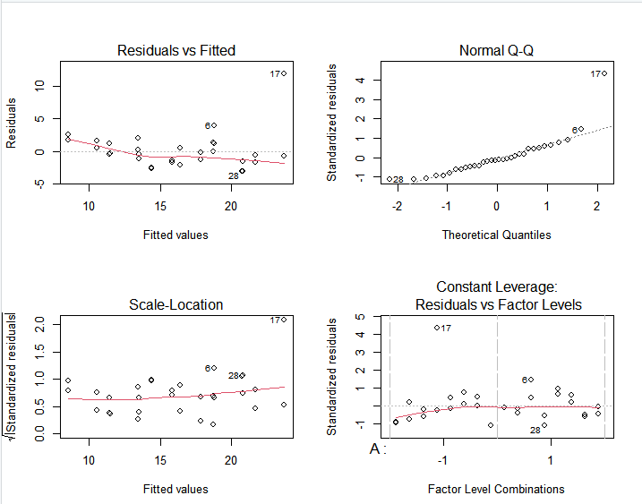
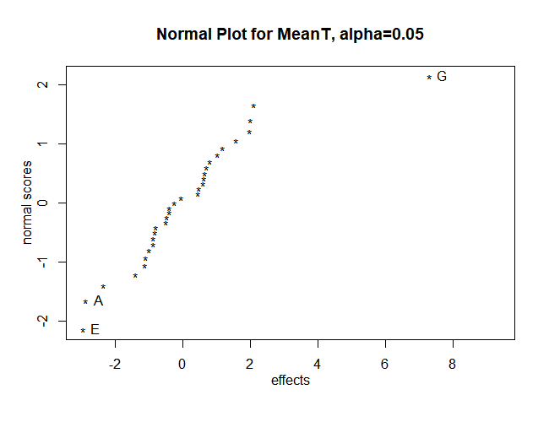
Analysis of Results : Mean time
Fig 4: Residual analysis
The normal probability plot of the effects (Daniel's plot) shows that factors A, E and G are significant or non-negligible.
These 3 factors were included in the ANOVA, so the others were pooled to the error term/residuals.
No concerns about residuals
Residuals vs fitted values: constant variance, no visible dependency*.
Residuals NPP: overall follow a normal distribution*
*obs.17 must be checked potential source of noise
Note: these main effects are confounded with 3-factor interactions. So, there is no need to add more runs to de-alias chains as we assume that the effect is due to the m.e. Alias chains up to 3f.i. are shown below:
A = BCF = BDG
E = [clear]
G = ABD = CDF
Fig 3: Daniel's plot for mean time

Slide 7
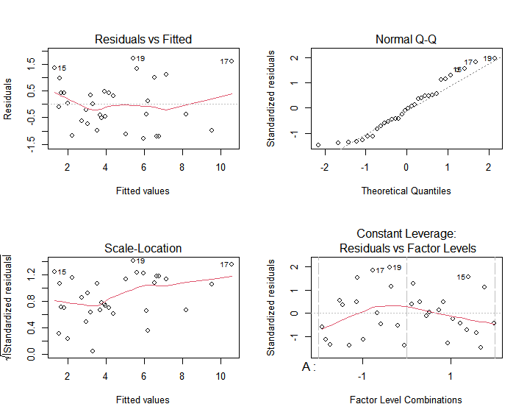
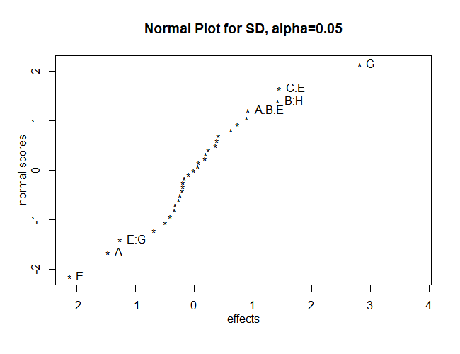
Analysis of Results : Standard Deviation
The normal probability plot of the effects (Daniel's plot) shows that main factors A, E and G, and interaction effects E*G, B*H, C*E and A*B*E are significant or non-negligible.
All of these (except the ABE interaction), are included in the ANOVA (to simplify the model analysis, and ABE is a three-factor interaction which is also close to the straight line, so its effect is not too significant).
Fig 6: Residuals analysis
No concerns about residuals
Residuals vs fitted values: constant variance, no visible pattern.
Residuals NPP: follow a normal distribution, only slightly differences
Note: these main effects and two factor interactions are confounded with 3-factor interactions. So, there is no need to add more runs to de-alias chains as we assume that the effect is due to the m.e. and 2fi. Alias chains up to 3f.i. are shown below:
A = BCF = BDG
E = [clear]
G = ABD = CDF
EG = ACH = BFH
BH = CDE = EFG
CE = BDH = AGH
Fig 5: Daniel's plot for standard deviation in time

Slide 8
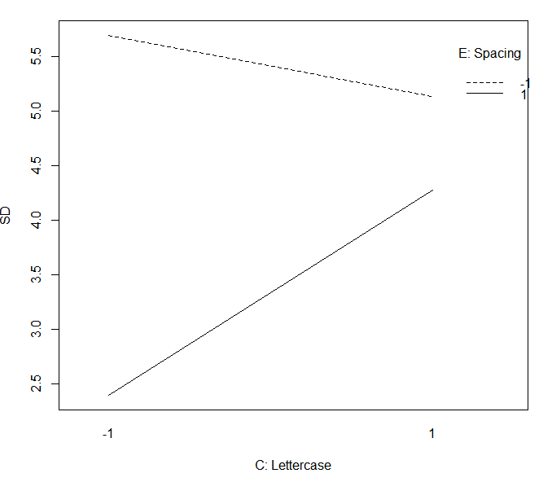
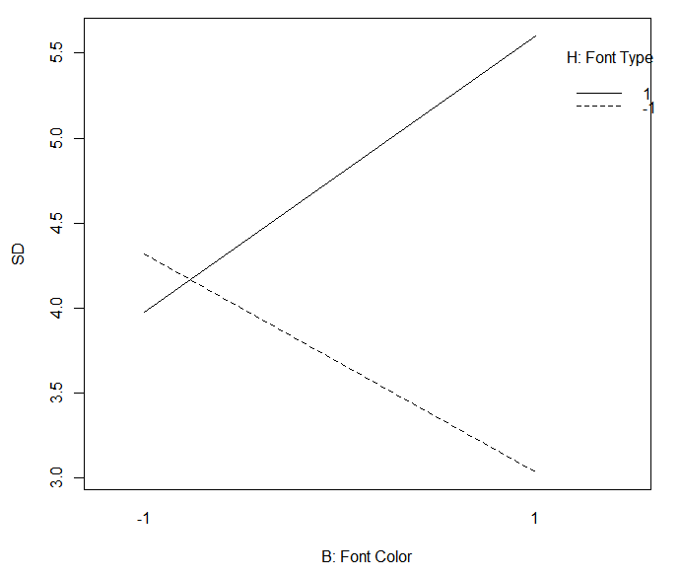
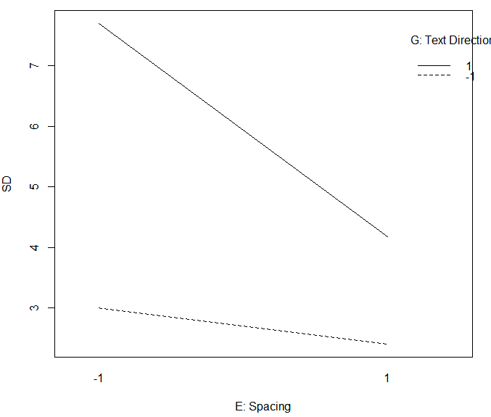
Interaction Plots for Standard Deviation
Fig 7: Interaction plot between C and E
Fig 8: Interaction plot between B and H
Fig 9: Interaction plot between E and G
For minimizing standard deviation, E at high level (double spacing) and C at low level (uppercase letter) is desired.
For minimizing standard deviation, B at high level (white font color) and H at low level (Arial font type) is desired.
For minimizing standard deviation, E at high level (double spacing) and G at low level (horizontal orientation) is desired.

Slide 9
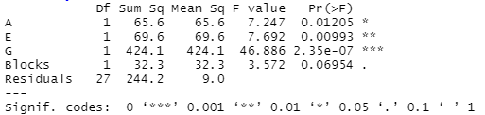
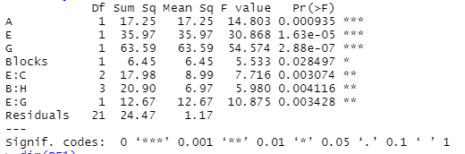
ANOVA for Mean Time and Standard Deviation
From the Normal Probability Plot of effects (mean time), it was found that factors A, E, and G are significant. ANOVA is done by pooling all other factors and their interactions as error to confirm the findings.
In the ANOVA, factors A, E, and G are significant.
Fig 10: ANOVA for significant effects in mean time
From the Normal Probability Plot of the effects (standard deviation), it was found that A, E, G, EG, CE, and BH are significant. ANOVA is done by pooling all other factors and their interactions as error to confirm the findings.
In the ANOVA, factors A, E, and G are the most significant and interactions EG, CE, and BH are also significant.
Fig 11: ANOVA for significant effects in standard deviation

Slide 10
Conclusions
FOR THE READING TIME MEAN → goal is faster reading, so min. mean
Main effect A (Font size): For reading posters, font size has a significant impact. Higher font size resulted in faster reading.
Main effect E (Spacing): Double spacing resulted in shorter reading time so double spacing is recommended for poster printing.
Main effect G (Orientation): Horizontal orientation of text direction reduces reading time.
FOR THE READING TIME STANDARD DEVIATION → goal is to reduce variability, so min. standard deviation
Interaction effect E*G (Spacing*Text Orientation): Higher level for factor E (double spacing) and lower level for G (horizontal orientation) is desired to reduce variability among readers.
Interaction effect B*H (Font color*Font type): It was significant for standard deviation. B at high level (white font color) and H at low level (Arial font type) is desired to minimize variability among readers.
Interaction effect C*E (Letter case*Spacing): E at high level(double spacing) and C at low level (uppercase letter) is desired to minimize standard deviation.

Slide 11
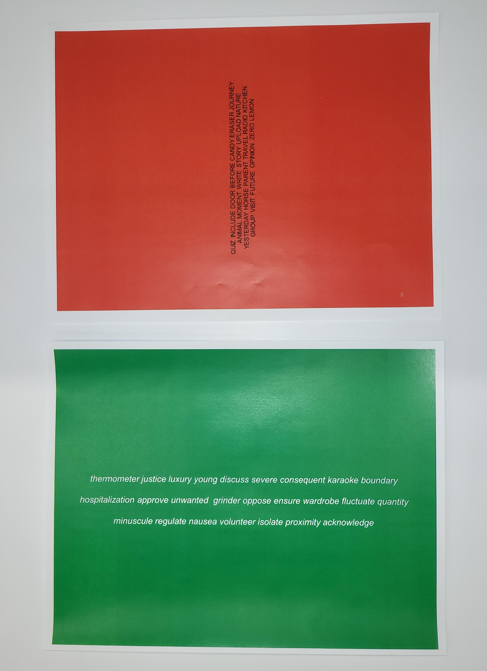

Photos of the Experiment (1/2)
Experimental equipment
Posters (2nd picture shows sample posters for each block)
Mobile Stopwatch
Measure tape (to measure the 5ft distance and reader's eyes level height).

Slide 12
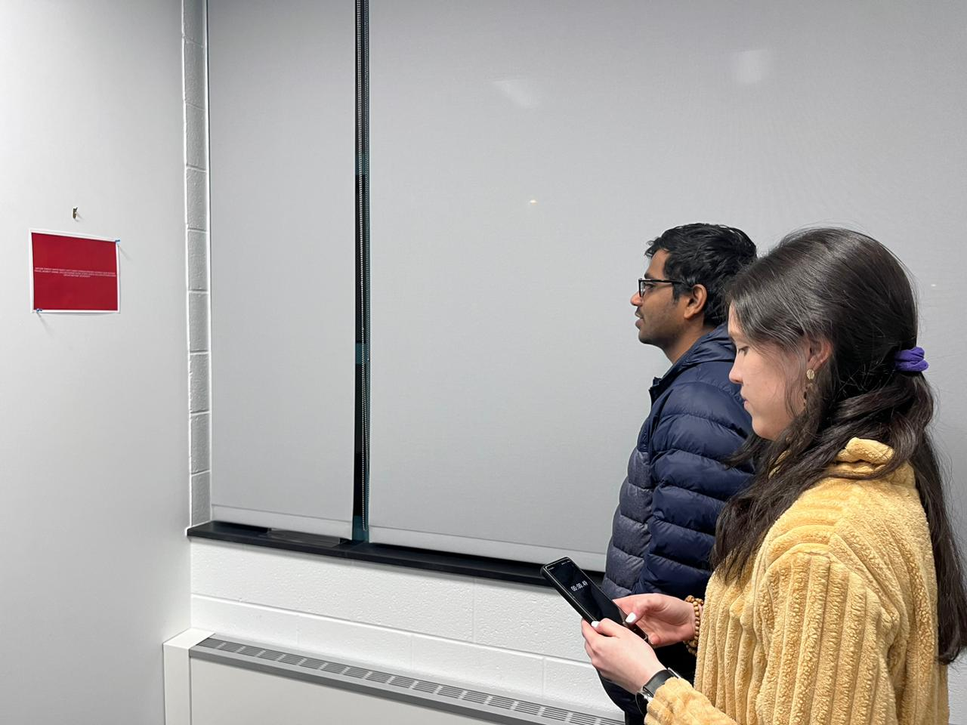
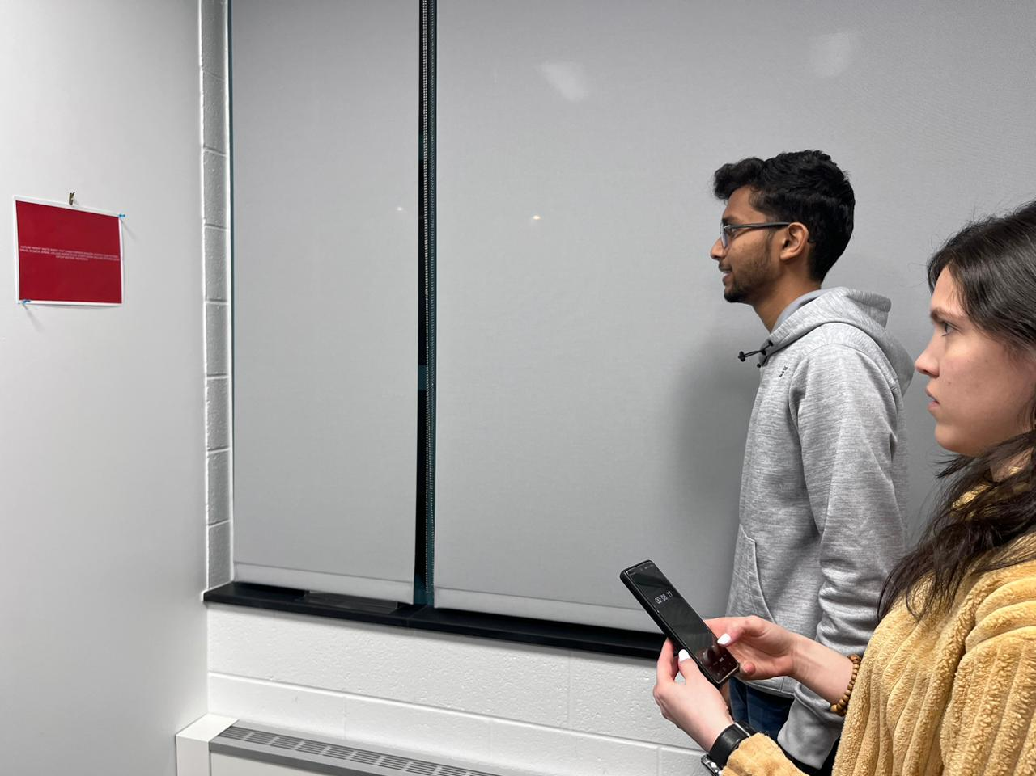
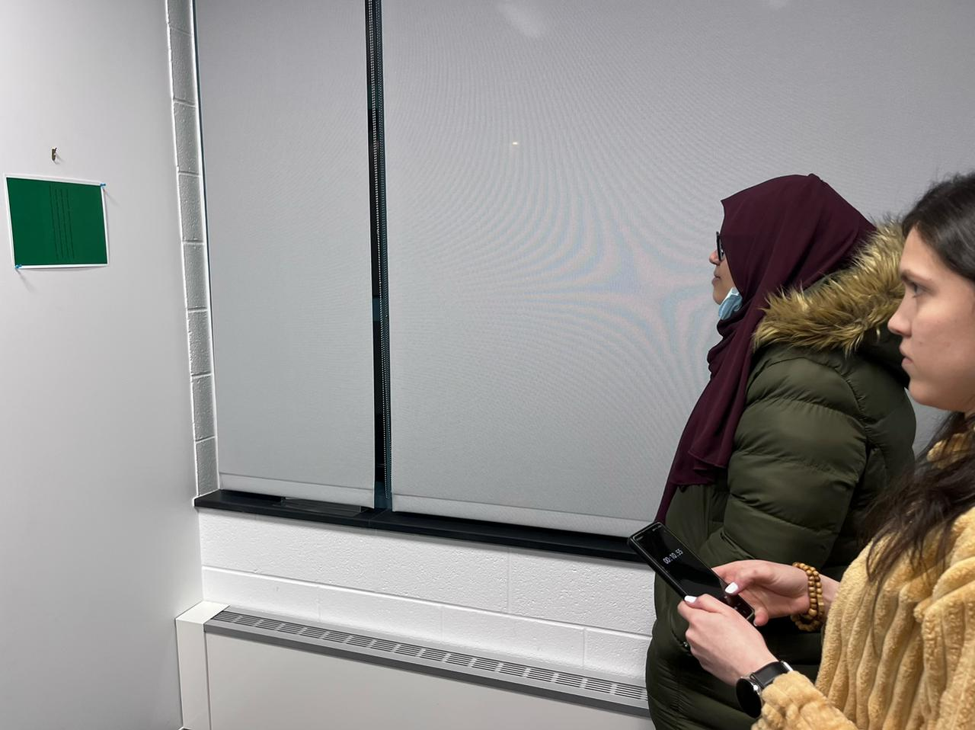
Photos of the Experiment (2/2)
Team members conducting the experiment

